Slide 1
Microaggressions and Building an Inclusive Culture
Brian Jones

Slide 2
In this session
Understanding Microaggressions
Being an advocate
Handling difficult conversations
Creating an inclusive culture
ROI
Q&A

Slide 3
Community Norms
Respect
Share to your comfort level
Embrace discomfort
Address the issue, not the person
Allow room for others to share
Any others?

Slide 4
Examples
“I love working with you, you think just like a man”
“I would’ve never guessed you grew up in a bad neighborhood, you act so professional”
“I know you said you are from Des Moines, but where are you REALLY from, like, before Iowa”
“You and your partner are so cute, I love gay couples! Why don’t you give him a kiss!”

Slide 5
What are Microaggressions?
The everyday slights, indignities, put-downs and insults that people of color, women, LGBT populations and other marginalized people experience in their day-to-day interactions.
A microaggression can appear to be a compliment but contain a “metacommunication” or hidden insult to the target group to which it is delivered.
They are often outside the level of conscious awareness of the perpetrator, which means they can be unintentional.

Slide 6
Intent vs Impact
Usually well intended, often attempt at compliment
Actually disparaging to one or more of your identities
Unconscious bias

Slide 7
Impact over time
Mosquito bite
Repeatedly
Situation could explode

Slide 8
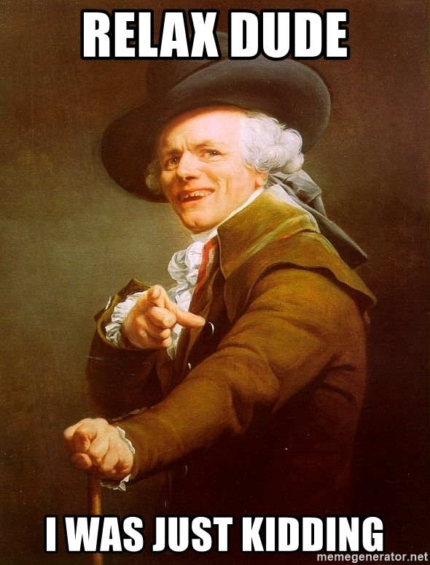
Being an Advocate
Listen
Address it
Create a culture

Slide 9
Having Difficult Conversations
Extend Grace
Address the issue, not the person
Use “I” statements
Clearly state why it was a problem
Offer an alternative

Slide 10
Case Study #1
Janet approaches Mary and says, “Mary, I just love your hair, it’s so cute and curly, how do you get it to grow that way”, while simultaneously running her fingers through Mary’s hair.
How would you handle this if you were Mary? A coworker who saw it happen? A leader whom Mary confided in?

Slide 11
Case Study #2
During team meetings, Derek is starting to make a habit of cutting off female co workers when they are speaking. He’s done it multiple times in different meetings, but only to females.
How would you handle this if you were one of the employees he cut off? A coworker in the meeting?

Slide 12
Case Study #3
Tim and Brian are having a conversation about putting on a company event for Black History Month and Tim says, “We should really get input from some black employees for this event. Oh yeah Brian, I guess you’re black, I don’t even think of you that way”.
How would you handle this if you were Brian? A coworker who saw it happen?

Slide 13
Having Difficult Conversations
Allow them to really hear you
Meet them where they are
Be clear in message

Slide 14
Creating an Inclusive Culture as an Organization
Unconscious bias training for your team, especially your leaders
Review Mentor Programs
BRG/ERG’s
Review Evaluation Process
Mitigate bias in the hiring process
Roundtable discussions about current events

Slide 15
Creating an Inclusive Culture as an Individual
Be an active advocate for your team-mates
Actively seek diverse opinions
Get to know someone new
Show humility
Inclusive virtual backgrounds
Using pronouns in email signature, etc
Offer space for others to share in meetings

Slide 16
Return on Investment
Only investment is effort and small amount of time
Higher Productivity
Higher Retention

